Slide 1


A Project On School Management System

Slide 2
Batch: 2022 – 6522
Center: Thane
Submitted by,
Kasturi D. Sarve
(ENROLLMENT NO. EBEON1221514763)
Under the Guidance of,
Chittaranjan Ghosh.
(Course Trainer)

Slide 3
INTRODUCTION
School Management System manages student information and teacher information in the school.
It storing information system. It has the facility of maintaining the details of the student and teacher, thereby reducing the manual work.
It will save time and energy which are spending in making reports and collecting data. School Management System can be accessed throughout the student and teacher with proper login provided.

Slide 4
Modules:
Teacher Management Module
Login
Admission Form
Close Admission
Check Student Information
Marksheet
Password Change
Logout
Student Management Module
Login
Student Details
check Timetable
Marksheet
Password Change
Logout

Slide 5
OBJECTIVE
The main objective of the School Management System is to manage the details of Schools, Students, Classes, Teachers, Registrations.
It manages all the information about Schools, Cources, Registrations, Schools.
To manage social change.
These systems work to coordinate scheduling and communications between faculty regarding students. This system exists to simplify information tracking for both parents and administrative staff.

Slide 6
SOFTWARE REQUIREMENTS
Back end: MySQL workbench 8.0 CE.
Front end: Java
Operating System: Window.

Slide 7
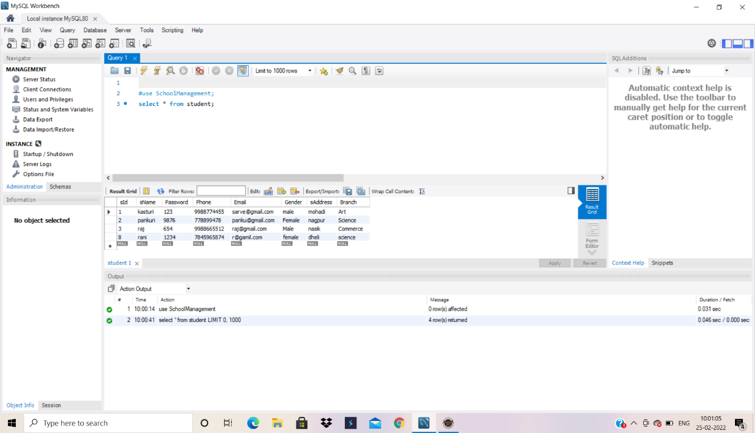
DATA DICTIONARY Create Database School:

Slide 8
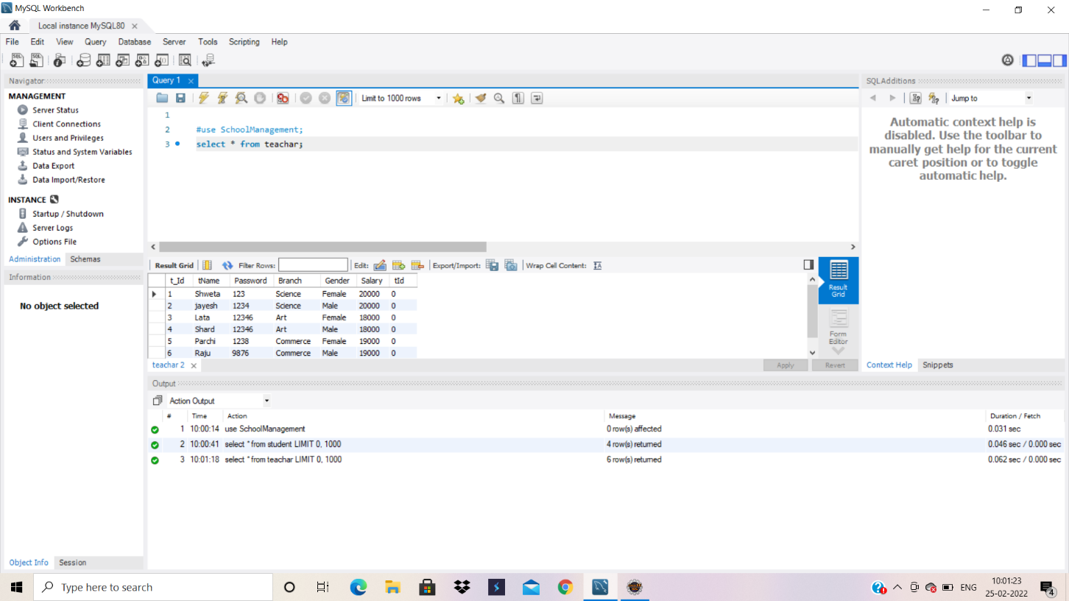
Create Database Teacher:
Create Database Teachar:

Slide 9
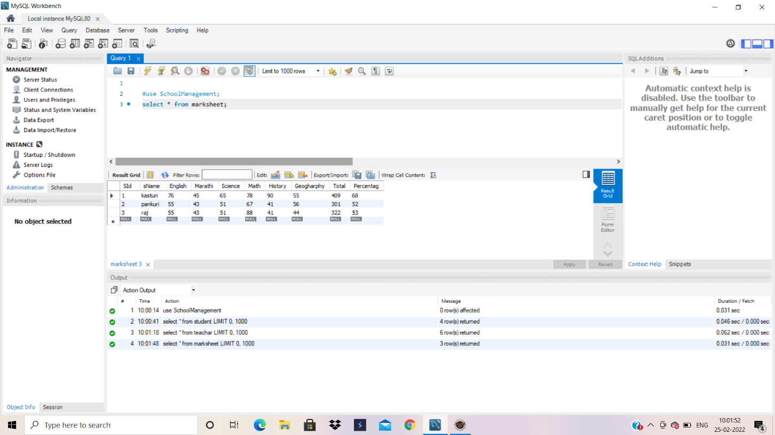
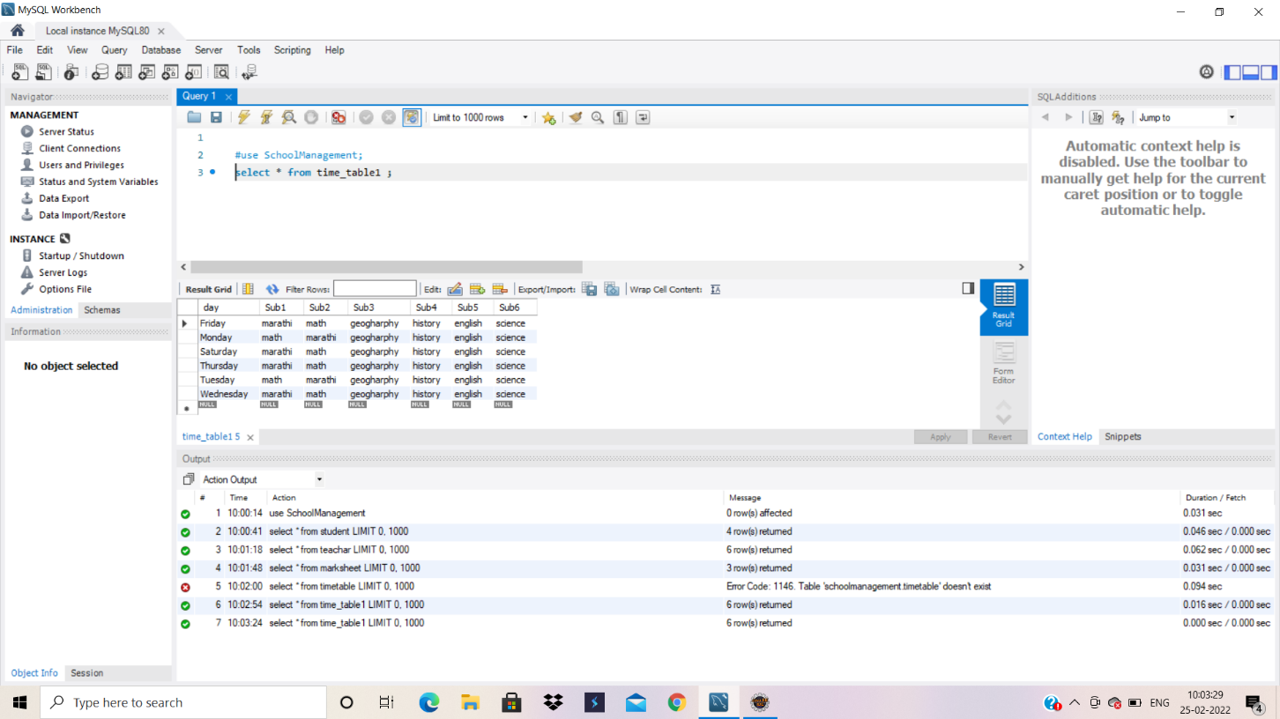
DataBase:
Create Database Marksheet:
Create Database Timetable:

Slide 10
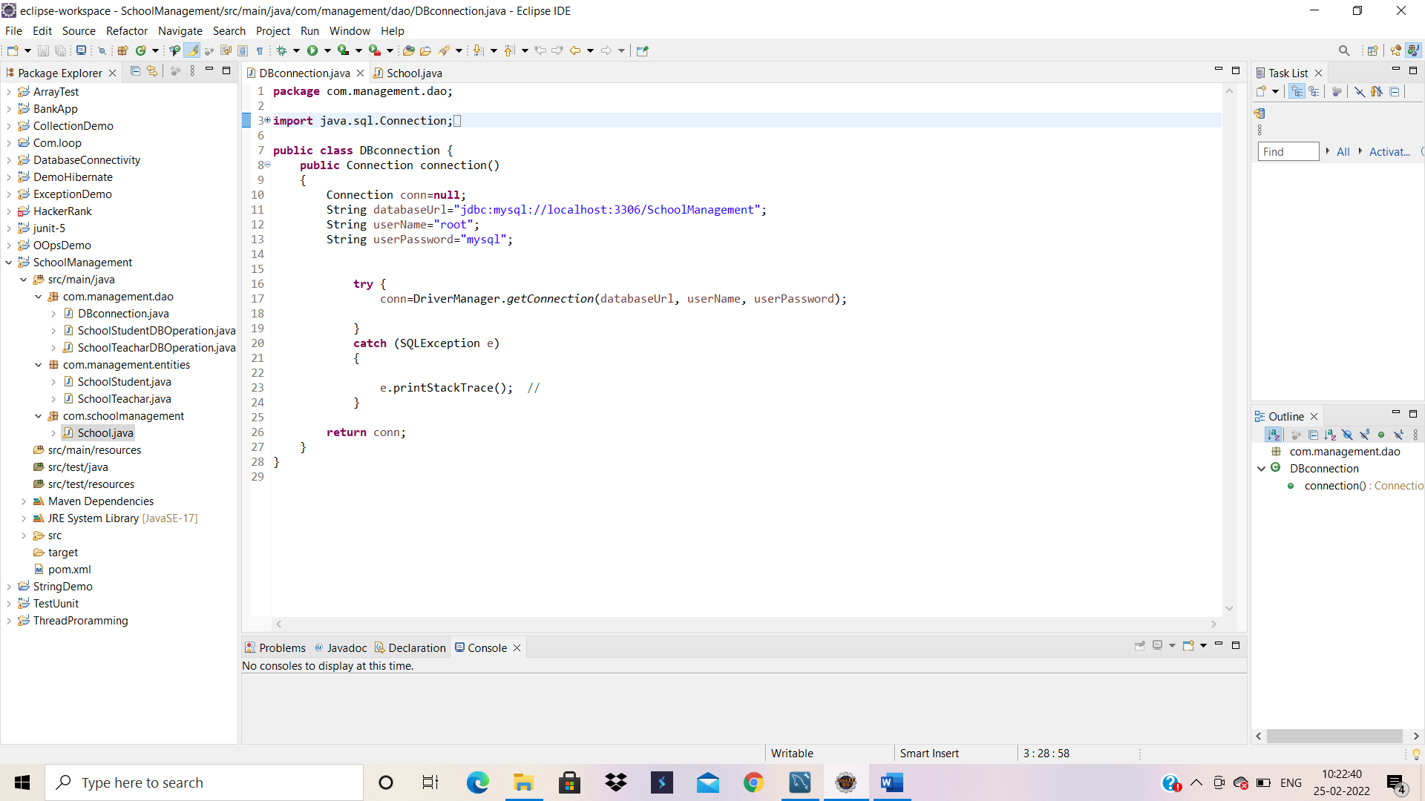
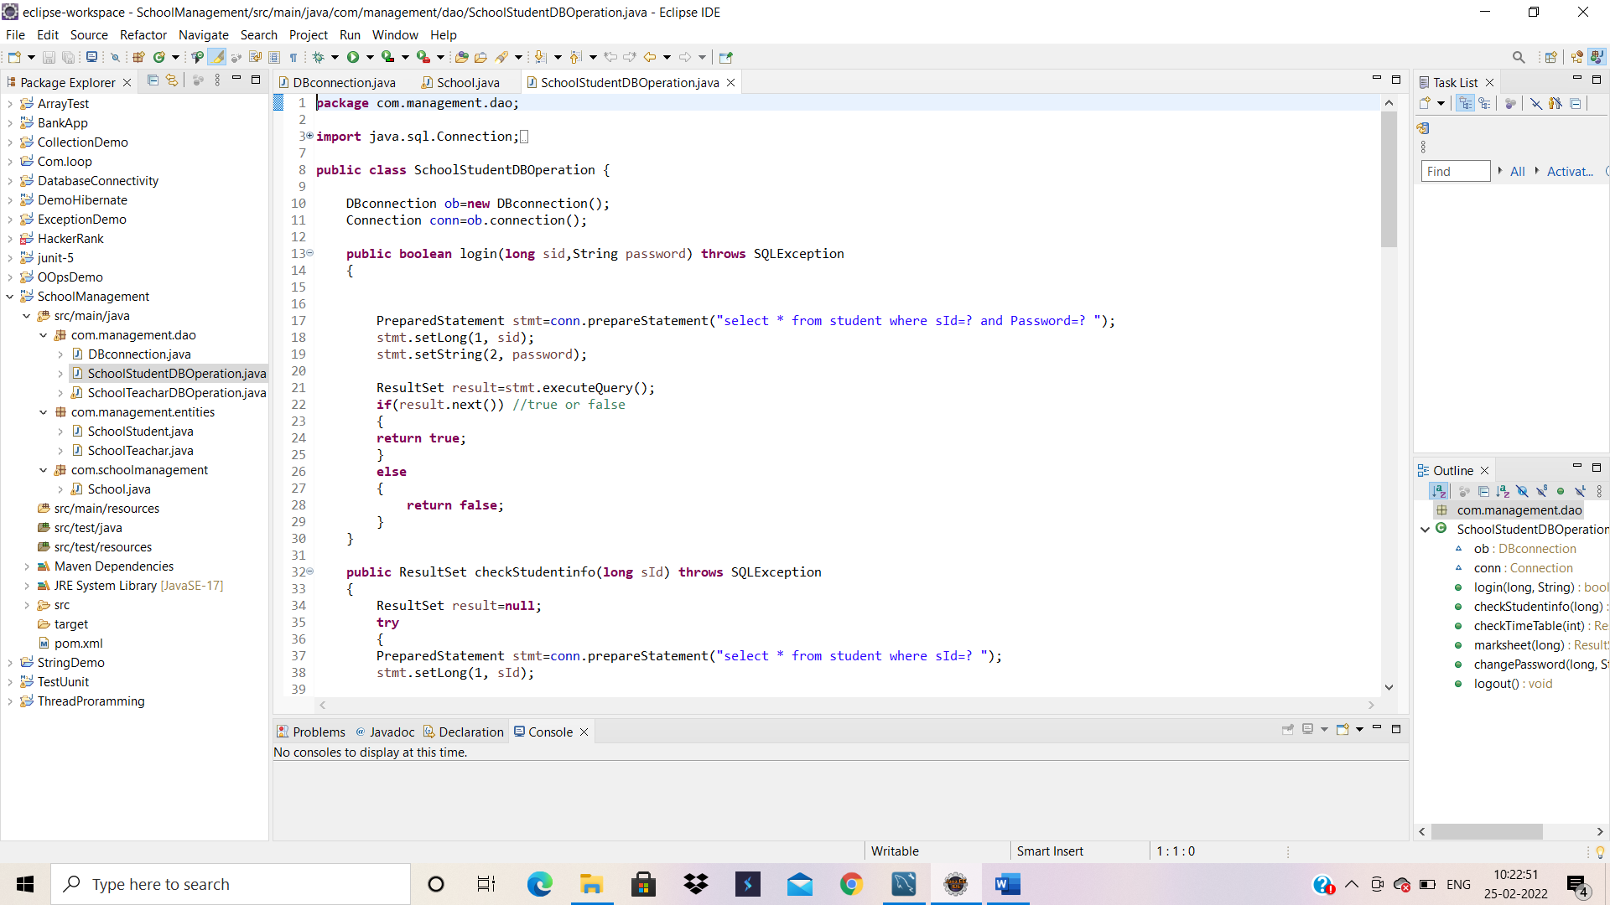
DBConnection Code:
DBConnection:
TeacherDBConnection:

Slide 11
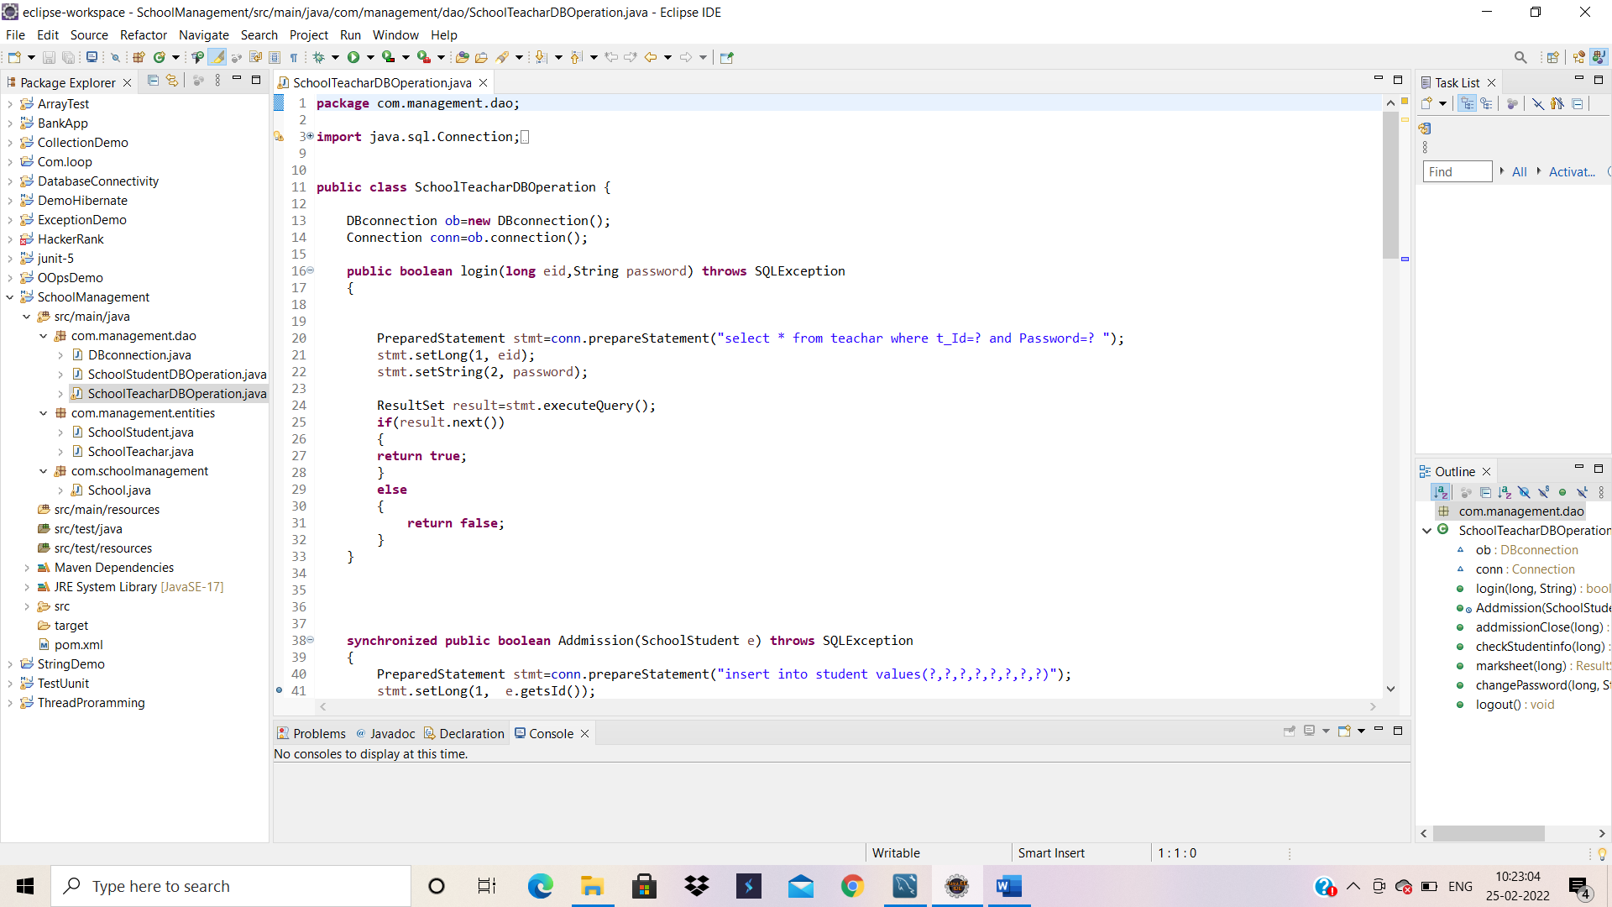
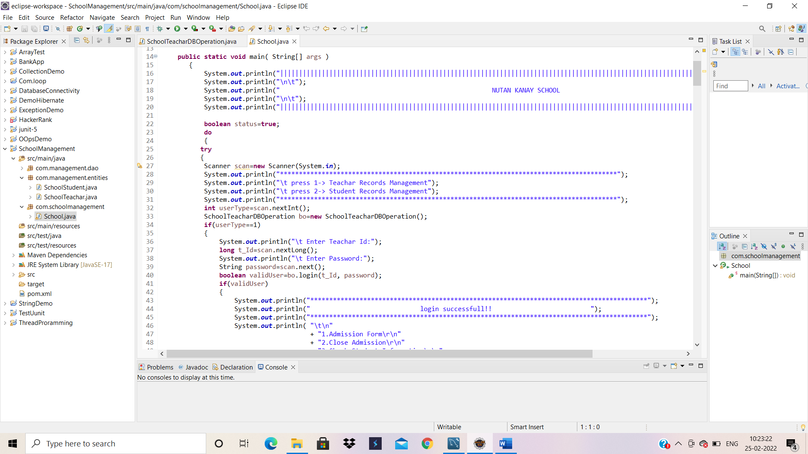
.
School.java:
SchoolDBOperation:

Slide 12
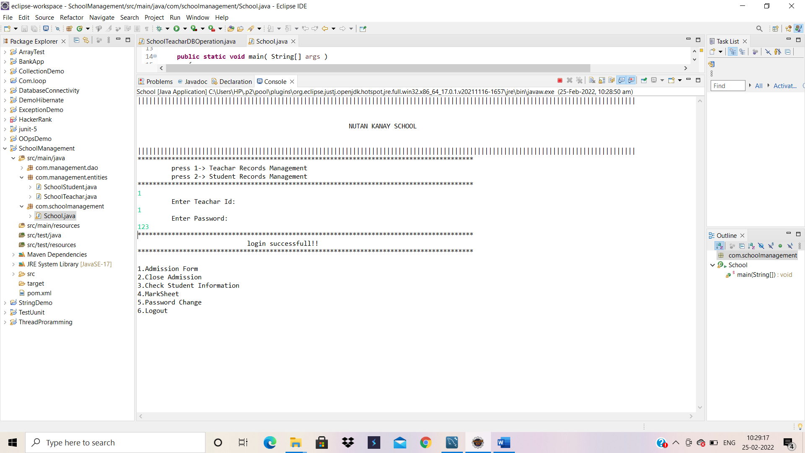
Output:

Slide 13
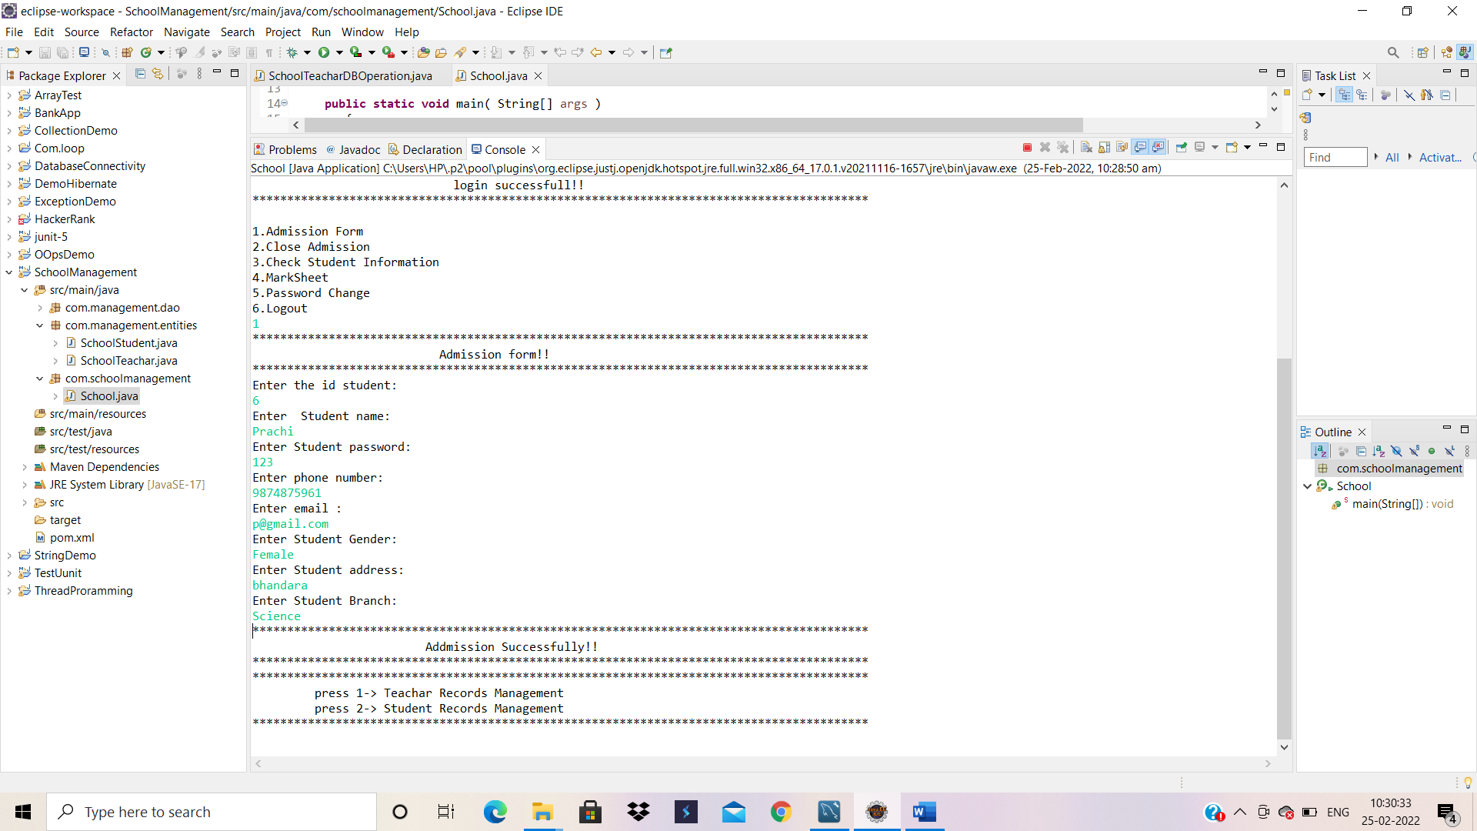
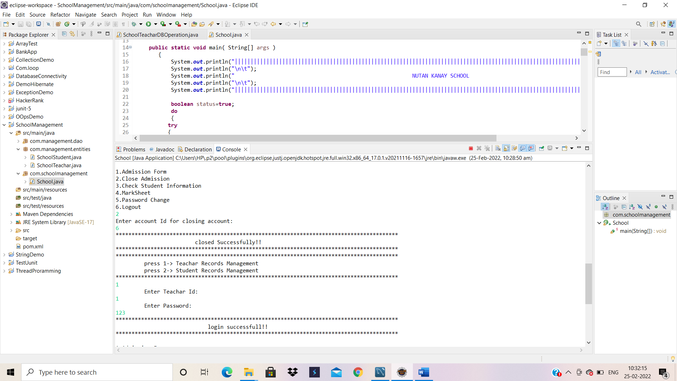

Slide 14
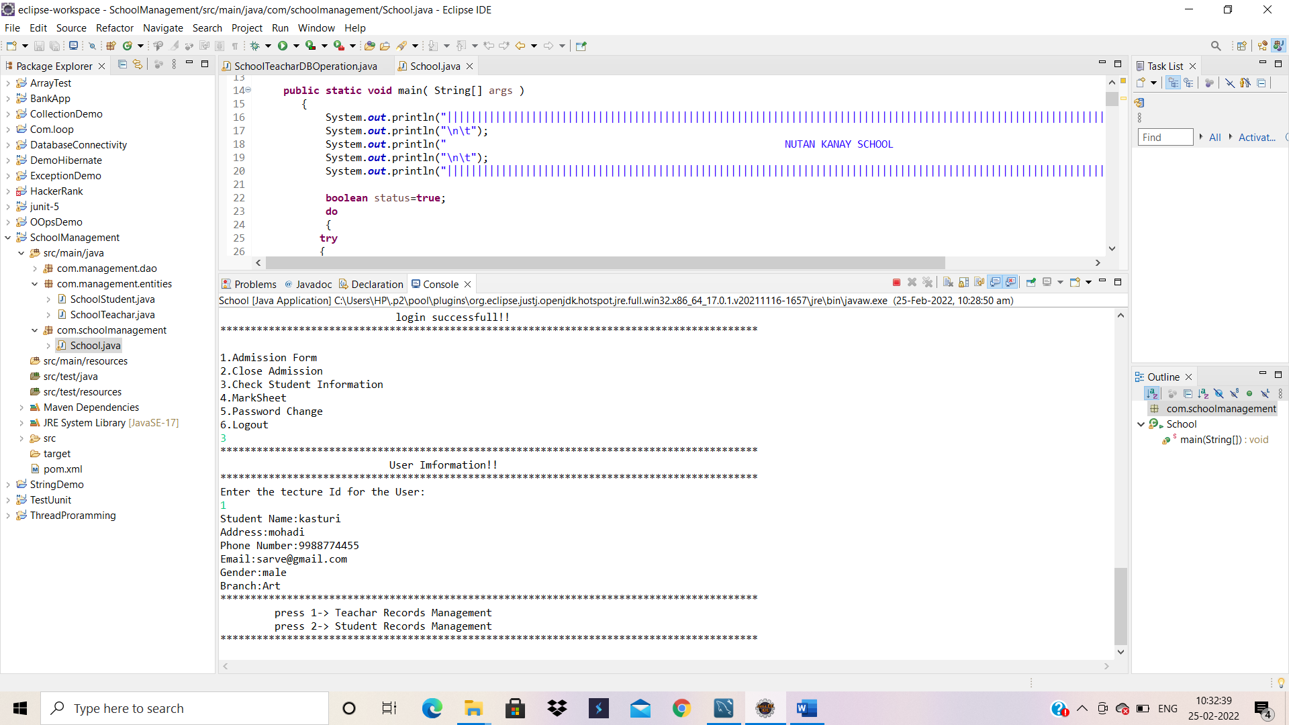
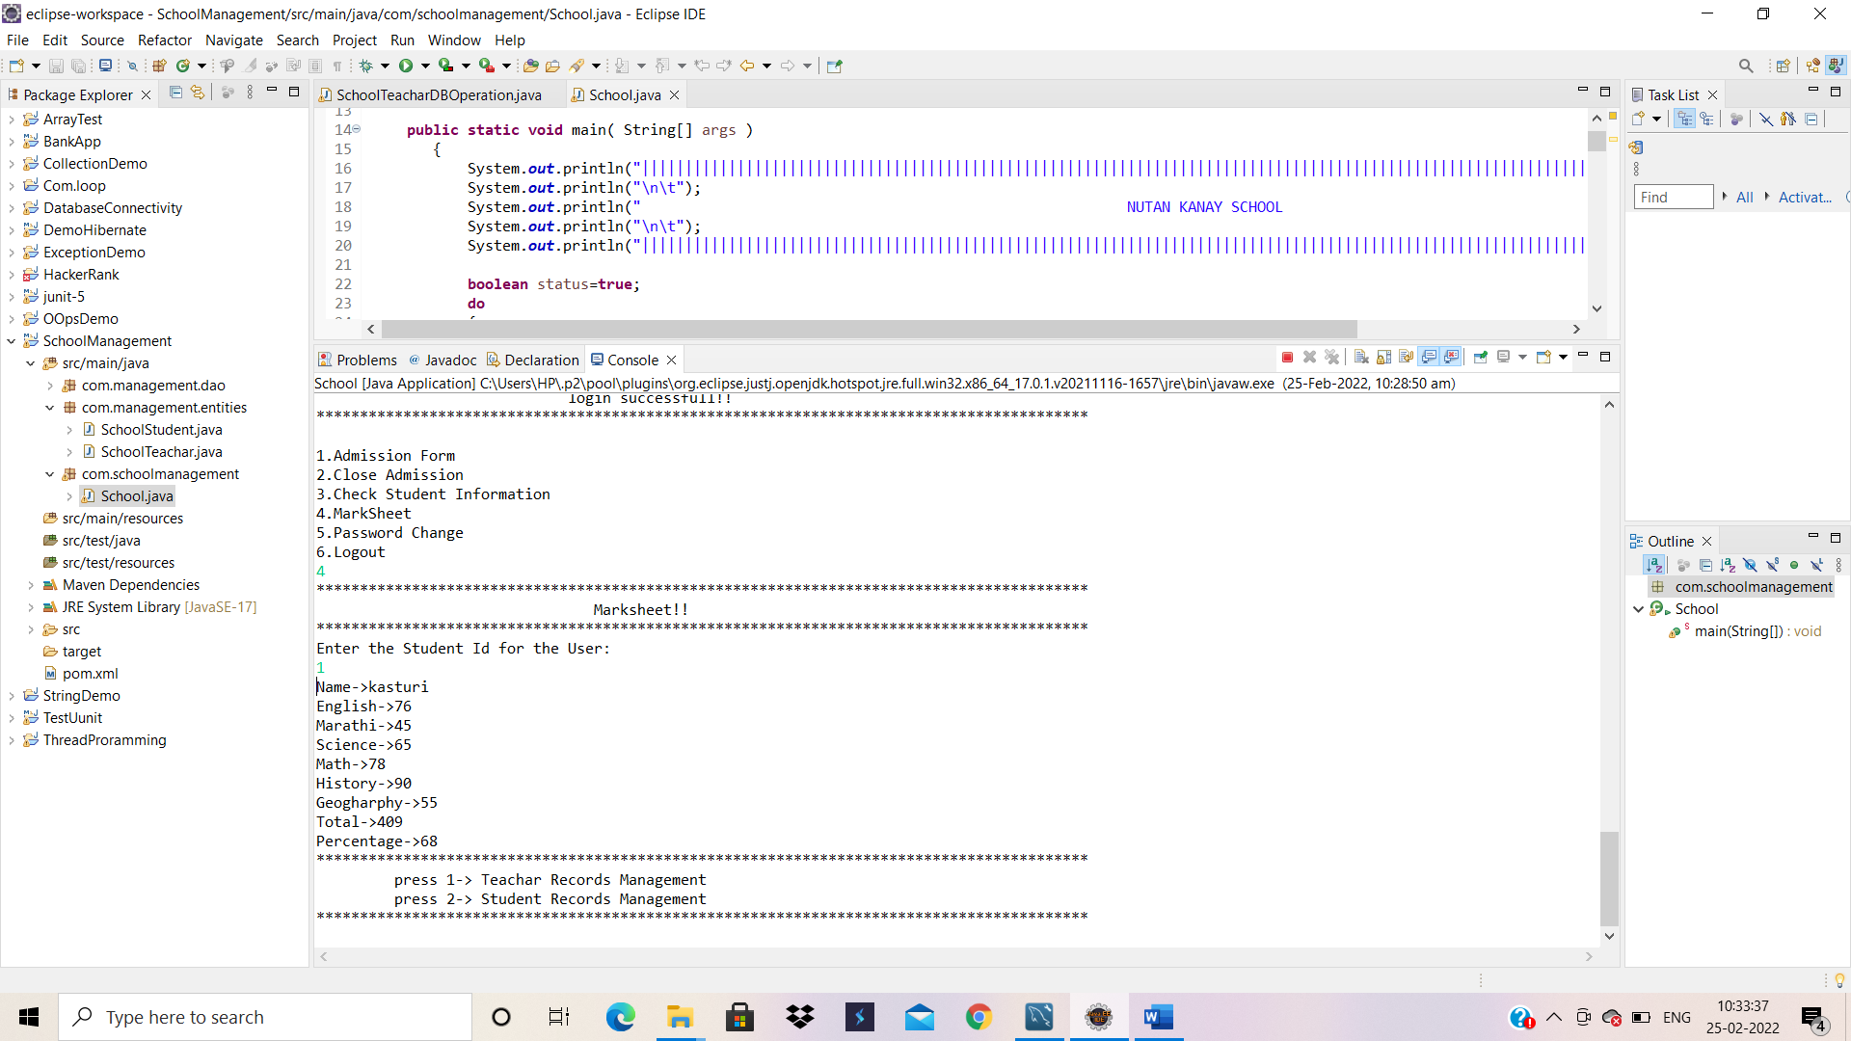

Slide 15
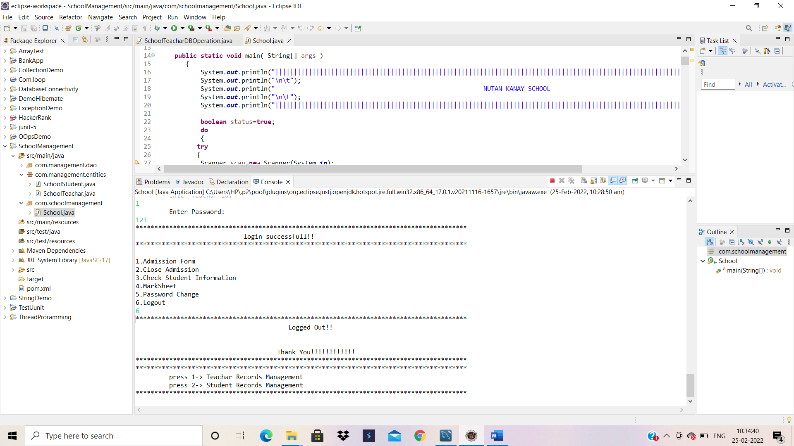
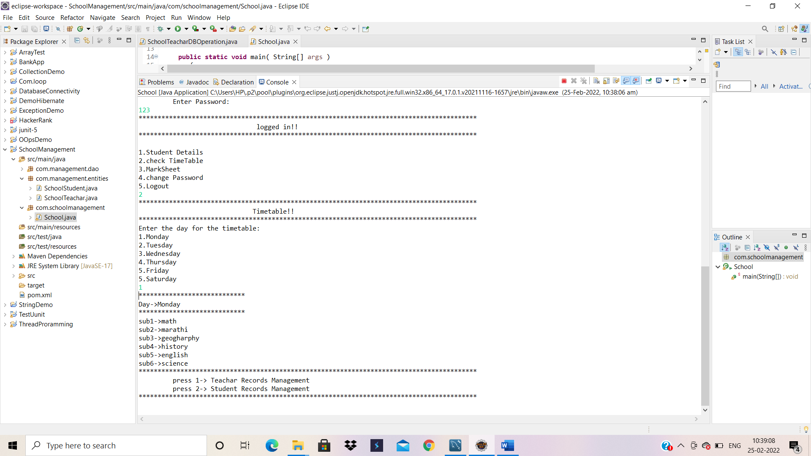

Slide 16
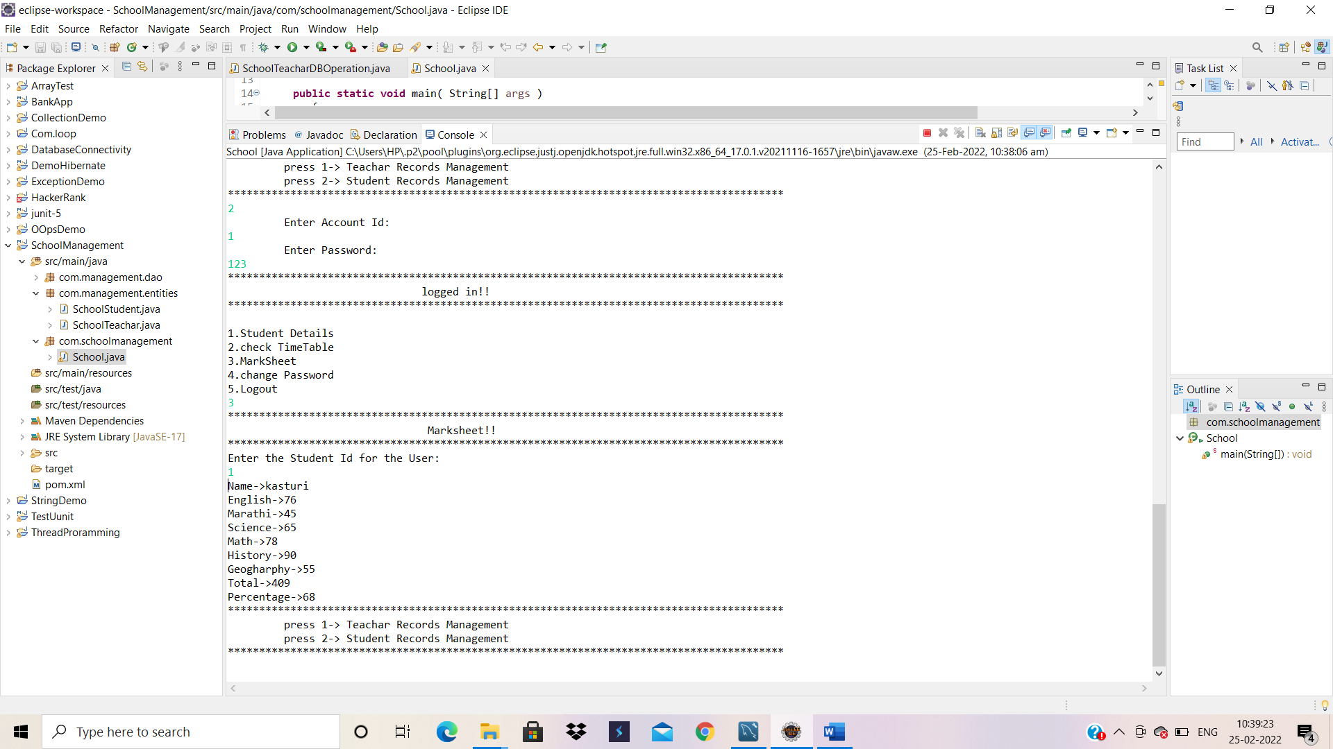
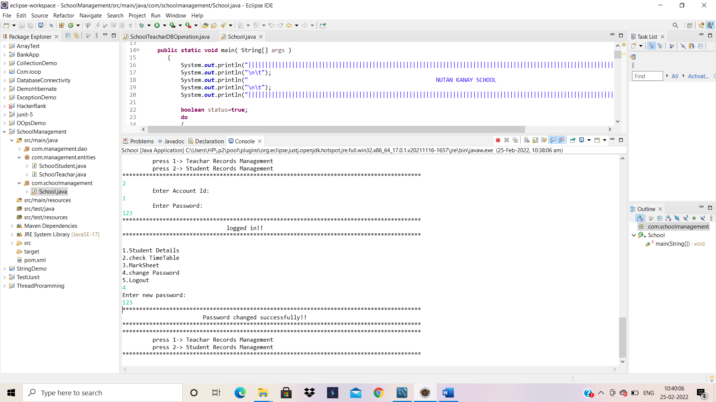

Slide 17
Thank you
someone@example.com

